Slide 1
AI-Powered Resume Screening & Job Matching System
Team Name: Nexus
Problem Statement: How can an AI-driven job matching platform analyze resumes and job descriptions to provide highly relevant candidate recommendations for recruiters?

Slide 2
Objective:
To create an AI-powered system that helps recruiters by automatically analyzing resumes and job descriptions. The goal is to provide recruiters with highly relevant candidate rankings and comprehensive reports, enabling data-driven and efficient decision-making.
Solution Overview:
1. AI-powered resume screening and job matching system
2. Automates the process of filtering resumes based on job requirements
3. Provides a matching score to determine the suitability of a candidate for a job
4. Extracts relevant information from resumes, including contact details, skills, and education

Slide 3
Key Features:
1. Resume Parsing
2. Job Matching
3. Filters resumes based on job requirements
4. Saves extracted data and matching scores to a CSV file
5. User Interface
Technologies Used: 1.Backend Framework: Flask(Python) 2.Natural Language Processing (NLP): NLTK, spaCy (Python) 3.Machine Learning: scikit-learn (Python) 4.PDF Processing: PyPDF2 (Python) 5.Frontend Framework: None (simple HTML/CSS/JS)

Slide 4
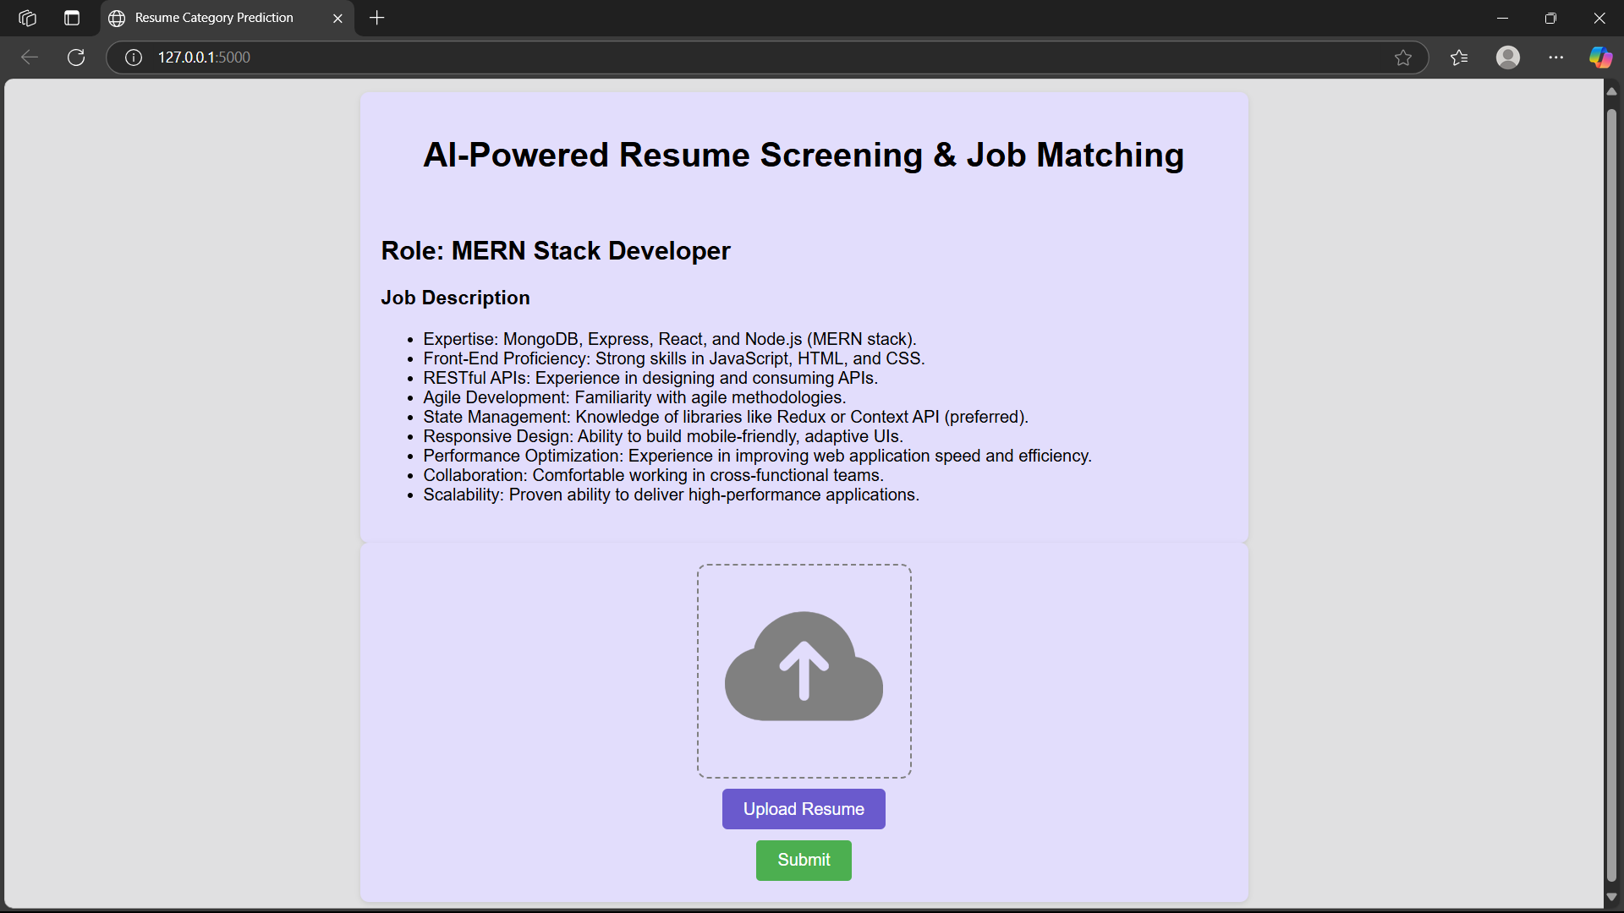
Solutions Implemented:

Slide 5
Challenges Faced:
Handling Different Resume File Types
Ensuring Accurate Matching Scores
Handling Poorly Structured Resumes
Synonym & Keyword Variability

Slide 6
Thank You

